Slide 1
Barkha’s Tool Box
Here is where your presentation begins

Slide 2
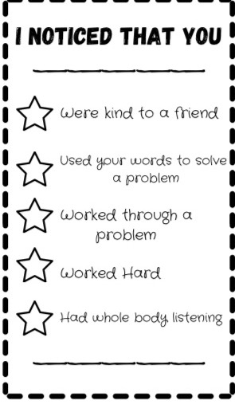
Positive Class
Environment
This is a great idea for an exit slip to do once a week with students. Creates a positive environment for the students and fills each others buckets ☺

Slide 3
Brain Breaks
Bouncy Balls are great to keep on hand as you can create many different brain breaks with them.
Such as: hot potato!
Brain breaks without material:
Freeze dance
Simon Says
Breathing exercises

Slide 4
Mindfulness
Bouncy balls can also be used in replacement of a talking stick, students can pass the ball around and share how they feel in the morning.
My Gratitude Jar:
Great activity to do once in a while with students for them to reflect on what they are grateful for that day, week or month.

Slide 5
Onomatopoeia Matching Game
I created this game for my practicum and it can be adapted for many different subjects! You can do it as a class activity or in pairs. The students have to find their matching onomatopoeia to the picture.

Slide 6
Creative Ways to form groups (list from this semester)
Cards
Popsicle Sticks
Dice
Colour construction paper under the chair
Names on ice cream to create an ice cream cone
French Fry Packets
Online Group Maker

Slide 7
Mini blocks to find a partner
Mini Blocks can also be used to group students together, fun way for students to find their partner. You can use the blocks to put numbers on them and ask the students to find their pair by finding the missing number that will create the sum of 10

Slide 8
Activates for when students finish early
Colouring sheets that also practice mindfulness
Playing cards can be played with partner to practice math games
Doodle books for students to draw
Catch up time for students to complete outstanding assignments

Slide 9
Resources for teachers
https://www.teacherspayteachers.com/
https://www.twinkl.ca/
https://www.education.com/
https://www.pinterest.ca/

Slide 10
Strategies to get classes attention (list from this semester & outside sources )
Eyes on me
Waterfall
Clapping Patterns
Hands on top it’s time to stop
Hocus Pocus its time to focus
Timer
Noisy app

